Slide 1



Welcome to Creative Writing—a world where we can finally see in our own way….

Slide 2


What kind of writer are you?

Slide 3

Why are you here?

Slide 4

What do you hope to gain from this community?

Slide 5

How will you challenge yourself?

Slide 6
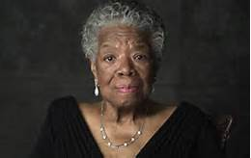
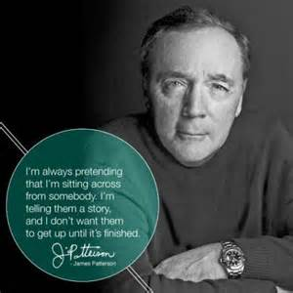
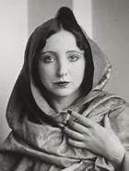
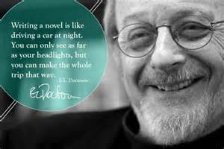
Will you listen to the voices before you or will you blazon a new trail?

Slide 7


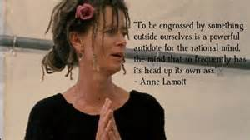
Required reading
“For some of us, books are as important as almost anything else on earth. What a miracle it is that out of these small, flat, rigid squares of paper unfolds world after world after world, worlds that sing to you, comfort and quiet or excite you. Books help us understand who we are and how we are to behave. They show us what community and friendship mean; they show us how to live and die.”

Slide 8
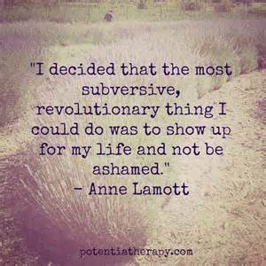
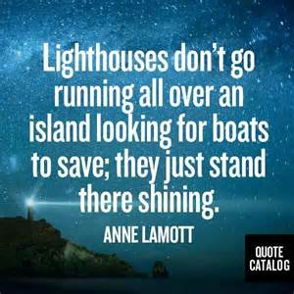

Slide 9
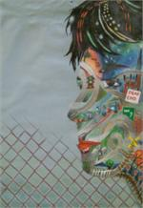
Developing the writing community
What is our process?
What do we love about stories?
How do we write?
What do we value
How can we jump into writing?

Slide 10
Assignments the first week
Write from your own experience:
Writing from experience---making experience happen
Street art, family and friends, selfies, concerts, a painting in a museum, funny signage. Many of us use our cell phones to capture photos and videos depicting everything from special occasions to the random striking visual encountered on a daily commute. Look through the photos on your cell phone and decide on a common theme, mood, or sentiment you’d like to convey in a poem or flash fiction. Are there photos you took by accident or ones you didn’t even know existed until browsing through? Write a poem consisting solely of descriptions of a selection of your photos. Which everyday objects, places, activities, or resonating visuals can you use to communicate a message?

Slide 11
Write a conversation without words:
(Character) Body English. Write a “conversation” in which no words are said. This exercise is meant to challenge you to work with gesture, body language (or, as a baseball announcer I heard once misspeak it, body English), all the things we convey to each other without words. We often learn more about characters in stories from the things characters do with their hands than from what they say.

Slide 12
Write an argument between two characters:
(Conflict & POV )The Argument. Two people are arguing—a man and a woman. They don’t have to be a couple. Each is convinced he or she is right. You, as the writer, do not know—and do not want to know—who is right, but you will have exquisite sympathy for both points of view, both sides of the argument. How do men and women argue differently? Couples tend to disagree over relatively minor issues, which often stand for larger issues. Give us enough background and history, but try to stay in the moment as much as possible.

Slide 13

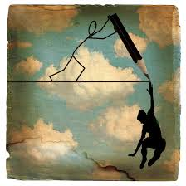
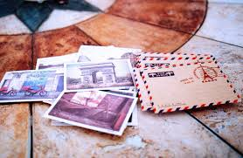
Penpal Project: communicate with creative writers in other classes

Slide 14



Breaking the ice---new ways to tell stories….
We will start class with fun writing activities

Slide 15
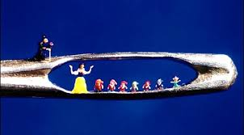

Assignment :Microfiction
For the writer:
As a writer, microfiction forces you to really look at your prose and determine what’s essential and what isn’t; what’s redundant and what isn’t. Honing these skills on microfiction can make your short story and novel-length prose that much sharper, but it’s also an art form of its own—a different medium for expression—as different from shorts stories as short stories are from novels. It’s fun to explore different story-telling media, and some writers find that microfiction is their medium of choice.
Tips for Writing Microfiction:
The real key to microfiction is efficiency of text. You don’t need to tell less of a story, and you don’t need to summarize the story. You need to make careful word and phrase choices that are able to paint vivid pictures and imply more than their brevity would suggest. “Show, don’t tell” most certainly still applies. Beyond that, consider all the features that tend to make any story good—characterization, plot, conflict, setting and atmosphere—if you want a reader to engage with the piece, there should be a hook, and some sense that something important happens. This is no small feat to perform in so few words, but it can be done. Cick here for an excellent example of Lydia Davis’s process.
Microfiction Monday : http://microfictionmondaymagazine.com/

Slide 16
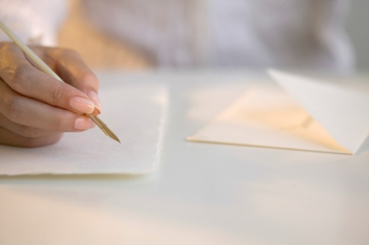
Assignment imitation writing
Pushing the Envelope by using imitation Writing: We all naturally gravitate to one type of genre, style, or rhythm in our own writing. Sometimes that skill communicates our thoughts perfectly and other times it sounds redundant and blah. Today we are going to try on other author’s writing styles and try to mimic his/her prose. This exercise is an attempt to break into a new perspective of style. Be patient. You will be surprised how rewarding this can be.

Slide 17
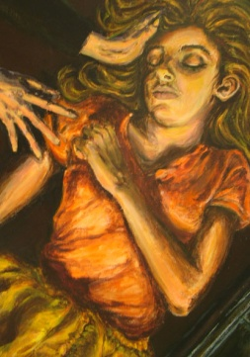
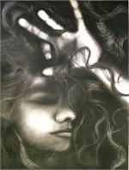
Assignment
Poetry
Our goal in writing this week is to enter the genre of poetry. This genre forces writers to pick diction wisely to show the reader an emotion, experience, story, etc…with precise, minimal wording. In addition, I want you to choose strong action verbs that will make this poem even more vivid and concrete.

Slide 18
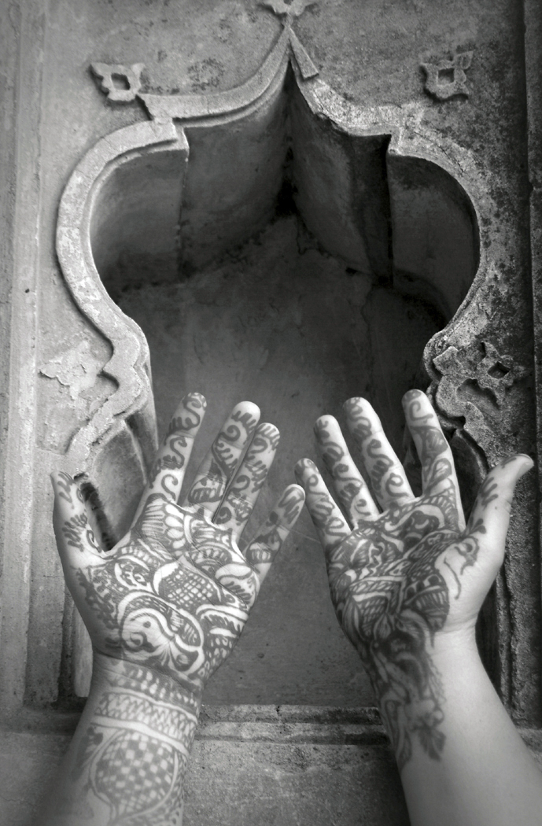
Poetry—
Work on clothing or hand poem/or observation poem (2nd year)—pick a location in the school to observe. Gather information and then compose a poem concentrating on concrete details/imagery and muscular verbs.
The goal of this assignment is to include strong concrete details.

Slide 19
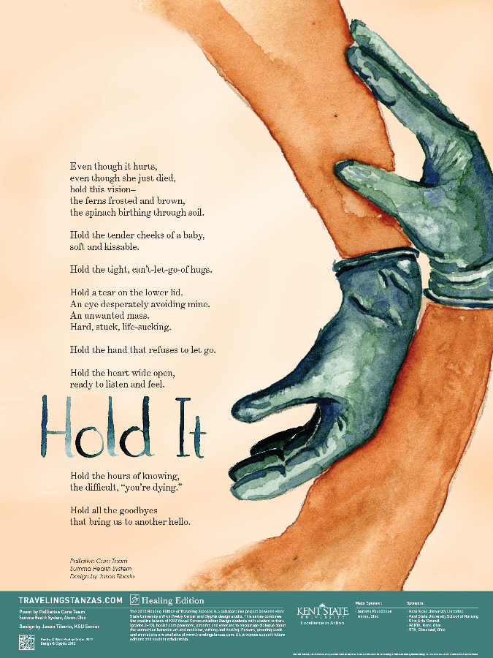
Assignment
Traveling Stanza
Traveling Stanzas originated as a collaborative project between Kent State University's Wick Poetry Center and Glyphix design studio. This series combines the creative talents of KSU Visual Communication Design students with student writers (grades 3–12), health care providers, medical students, patients, and veterans to encourage dialogue about the connection between art and medicine, writing and healing.

Slide 20
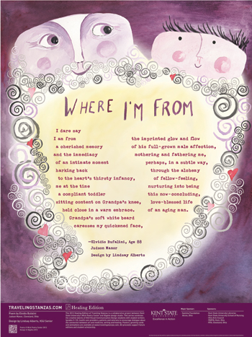
Traveling Stanzas KSU

Slide 21
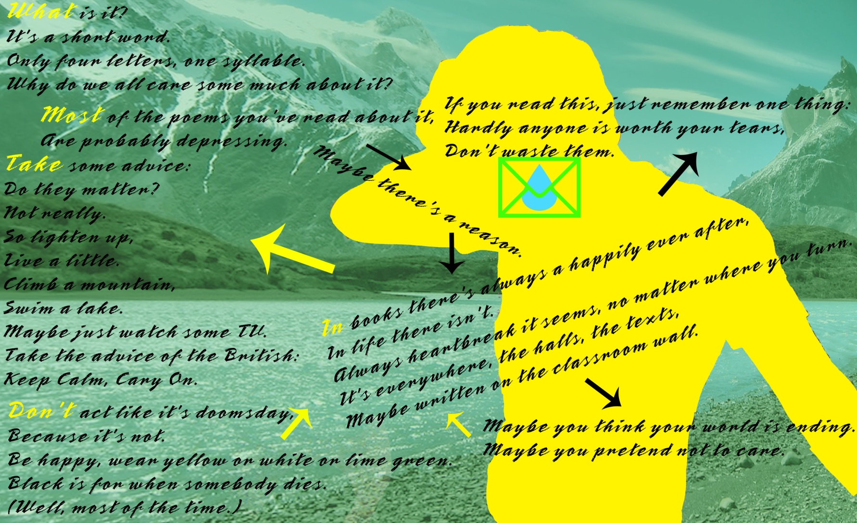
Traveling Stanzas MHS

Slide 22

Traveling Stanzas MHS

Slide 23



Assignment 6
College Essay
Write a college essay
From college or choice
Common application

Slide 24

Publishing
---Teen Ink & Voices Magazine
Teen Ink contest: http://www.teenink.com/Contests
Review requirements online
Choose between the fiction/nonfiction contests
Review the magazine to see models
Discuss deadline
Write for Teen Ink & Voices Magazine

Slide 25

Assignment ---Write a novel
November
Is
National
Novel
Writing
Month
☺

Slide 26

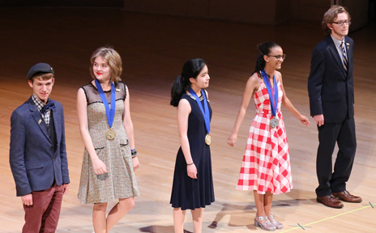
Scholastics Writing Contest:
Veteran students will be invited to write individual or portfolio work. Due in December
http://www.artandwriting.org/about-us/

Slide 27



Fieldtrips:
Lake Erie Ink---workshops/open mic
Open Mic Night at MHS
Lakeland Literary Festival---Creative Writing Workshops
---KSU—The Wick Poetry Center
    Write poems
    Speak with other poets
    Learn new writing strategies
    Meet and greet visiting poets

Slide 28
Signing Day

Slide 29

Writers write about themselves
Welcome parents

Slide 30

Helpful Hints for Success
Check Infinite Campus— a grade will be recorded and a “explanation” of the assignment grade will be listed
Late work is not accepted so help students with time management skills
Encourage your student to make a conference with me
Ask for help---help students be proactive about their academic career. Even if you coach them on what to say, have them practice the face-to-face communication. It will really empower them.
Call me or email me; kbeery@mayfieldschools.org
440-995-6954
I am available for extra help during 3rd period or by appt.

Slide 31
Assignment 1
Letter Writing
Letter writing is an intimate
lost art in our society.
It is an informal and
informational piece of writing
that we will rediscover.
Please write 3 handwritten
letters to:
A friend at MHS
A teacher at MHS
A person of your choice at MHS
(counselor, coach, band director, lunch aid, principal, tutor, mentor, secretary, custodian, etc…

